Slide 1


05/06/2026
FOOD FORMULATION PLATFORM
Wireframe Design & User Workflow Presentation
PROJECT MENTOR :
PRESENTED BY:
Dr. Puneet Singh Thakur
Scientist, R&I Labs
Deepak Singh Porte
Emp. ID - 3279265

Slide 2
HOMEPAGE OVERVIEW
Homepage Purpose
The homepage serves as the primary entry point to the platform, introducing users to AI-driven food formulation capabilities, workflow options, ingredient resources, and scientific validation features through a structured and intuitive interface.
Core Components
Hero Section
Problem Statement
User Path Selection
Platform Workflow
Ingredient Library
Scientific Credibility Metrics

Slide 3
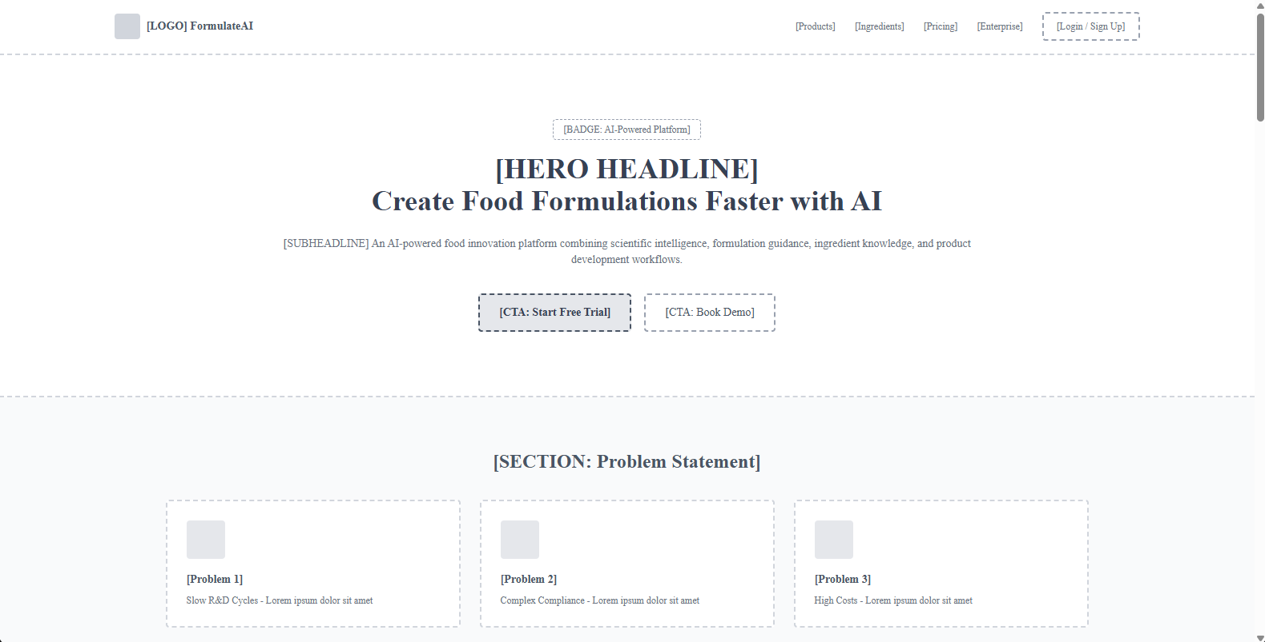

Slide 4
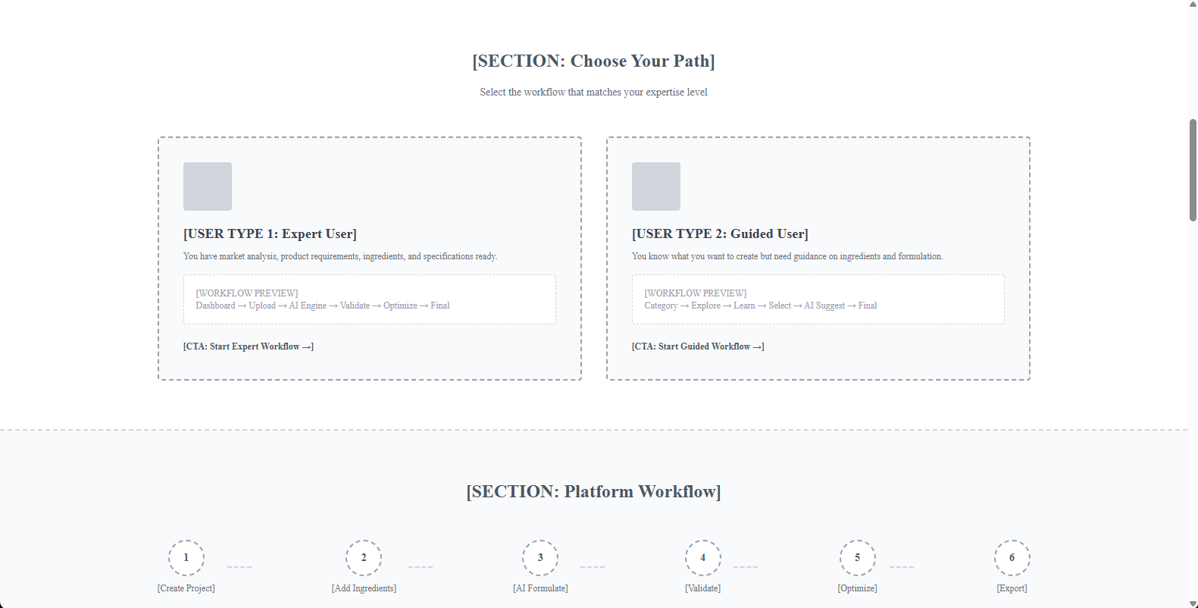

Slide 5
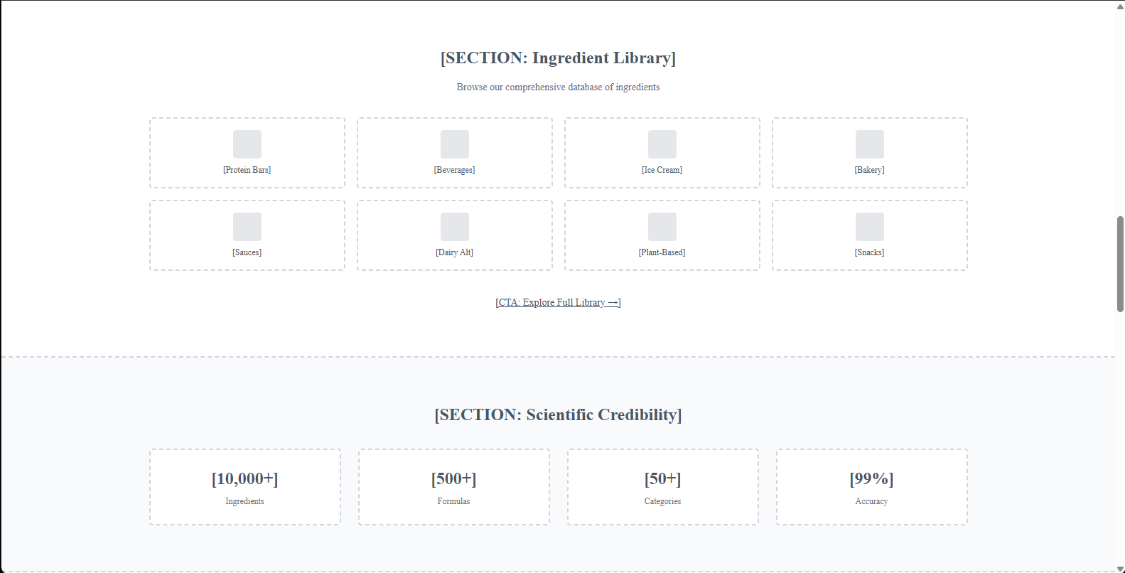

Slide 6
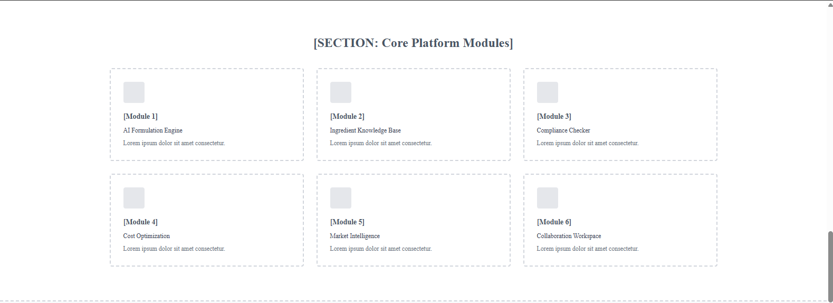

Slide 7
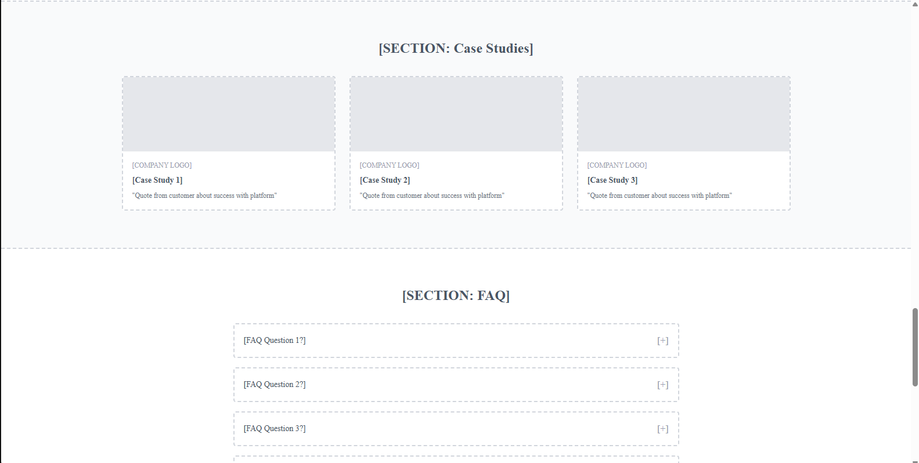

Slide 8
USER DASHBOARD & PROJECT MANAGEMENT
Purpose
Centralized workspace for managing food formulation projects.
Key Highlights
Project and formulation overview.
Expert & Guided workflow access.
Progress tracking and status monitoring.
Quick actions for reports and compliance.
Activity and notification management.
Benefits
✓ Faster Project Management
✓ Better Visibility
✓ Streamlined Workflow

Slide 9
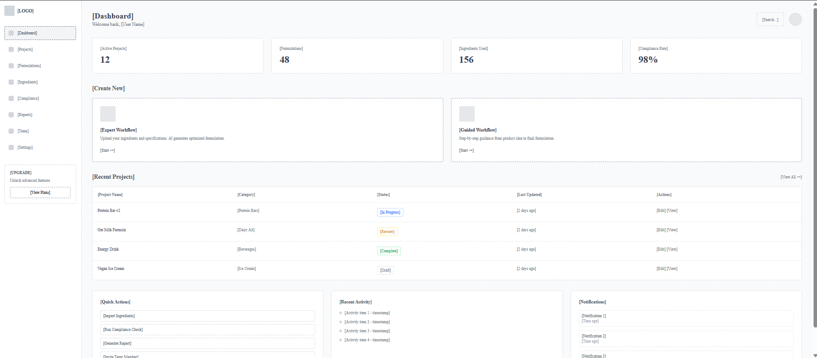

Slide 10
INGREDIENT LIBRARY
Purpose
Centralized repository for exploring, comparing, and selecting ingredients for food formulations.
Key Highlights
Search and filter ingredients by category and function.
Compare ingredient properties and costs.
View detailed ingredient specifications.
Discover alternative ingredient options.
Direct integration with formulation workflow.
Benefits
✓ Faster Ingredient Selection
✓ Better Decision Making
✓ Improved Formulation Accuracy

Slide 11
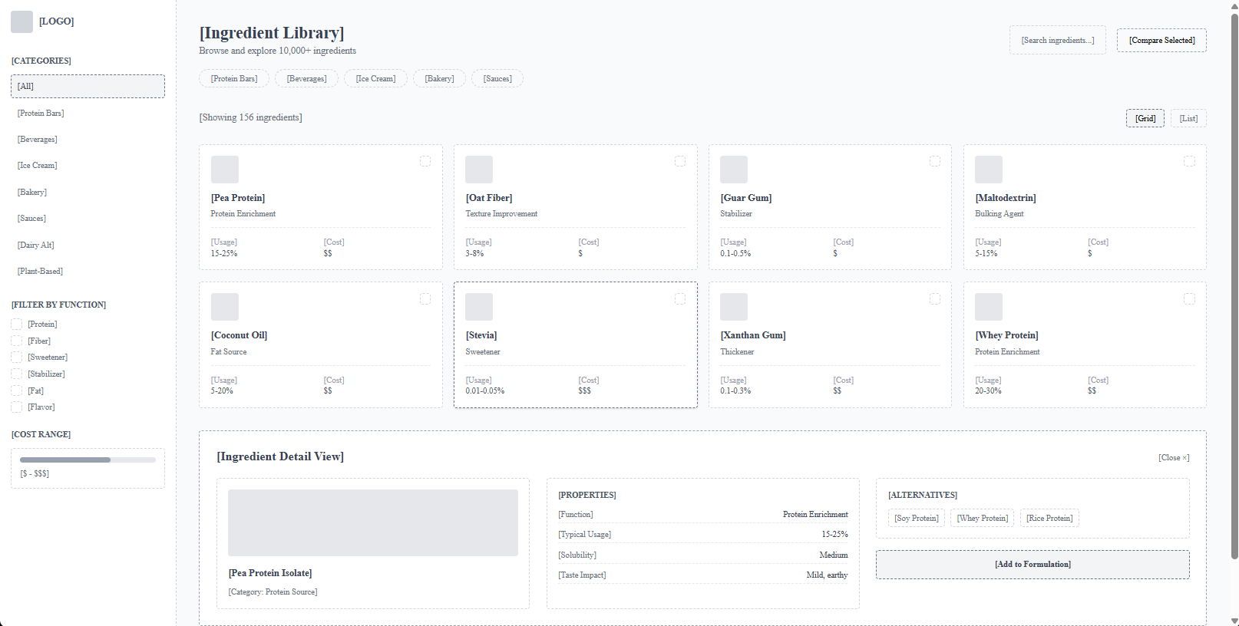

Slide 12
EXPERT USER WORKFLOW
Purpose
Enables expert users to create and optimize formulations using AI-assisted recommendations and real-time analysis.
Key Highlights
Ingredient composition management.
AI-powered formulation suggestions.
Nutrition and cost analysis.
Compliance validation checks.
Formula optimization and export options.
Benefits
✓ Faster Formulation Development
✓ Cost Optimization
✓ Regulatory Compliance

Slide 13
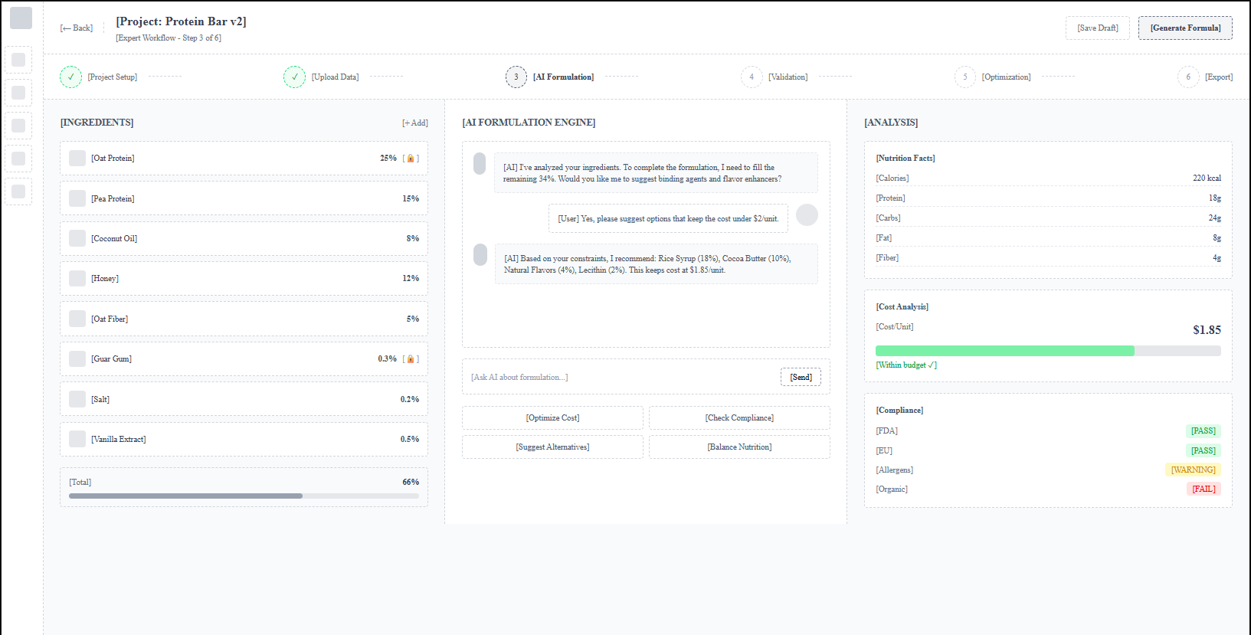

Slide 14
GUIDED USER WORKFLOW
Purpose
Guides users through food formulation with step-by-step AI assistance.
Key Highlights
Product category selection.
Natural language idea input.
AI-assisted ingredient exploration.
Guided ingredient selection and learning.
Progressive formulation workflow.
Benefits
✓ Beginner-Friendly Experience
✓ Guided Decision Making
✓ Reduced Learning Curve

Slide 15
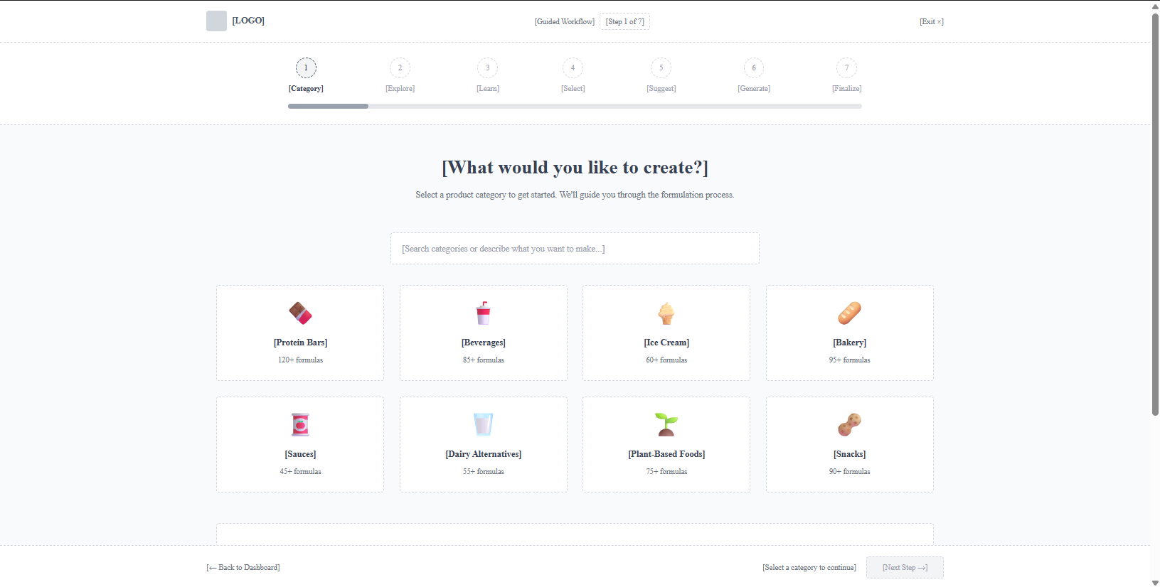

Slide 16
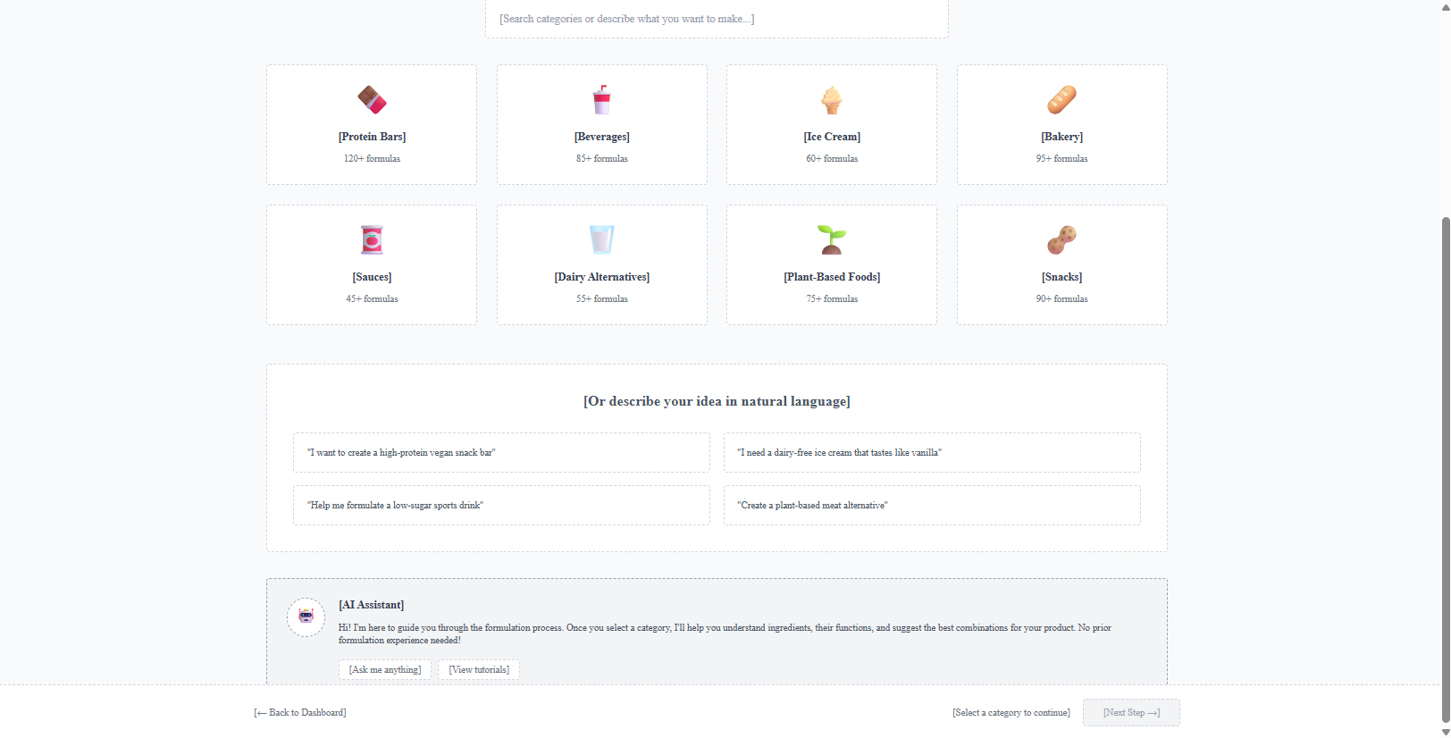

Slide 17
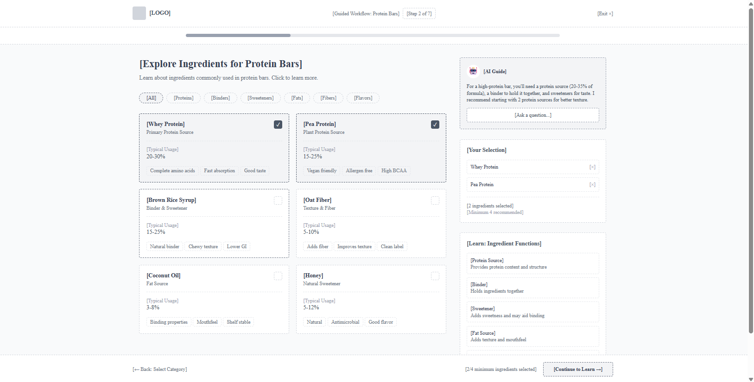

Slide 18
COMPLIANCE DASHBOARD
Purpose
Provides real-time visibility into formulation compliance across global regulatory standards.
Key Highlights
Regional compliance monitoring.
Automated alerts and warnings.
Compliance audit and reporting tools.
Formulation validation tracking.
Regulatory issue management.
Benefits
✓ Improved Regulatory Readiness
✓ Faster Compliance Reviews
✓ Reduced Risk of Non-Compliance

Slide 19
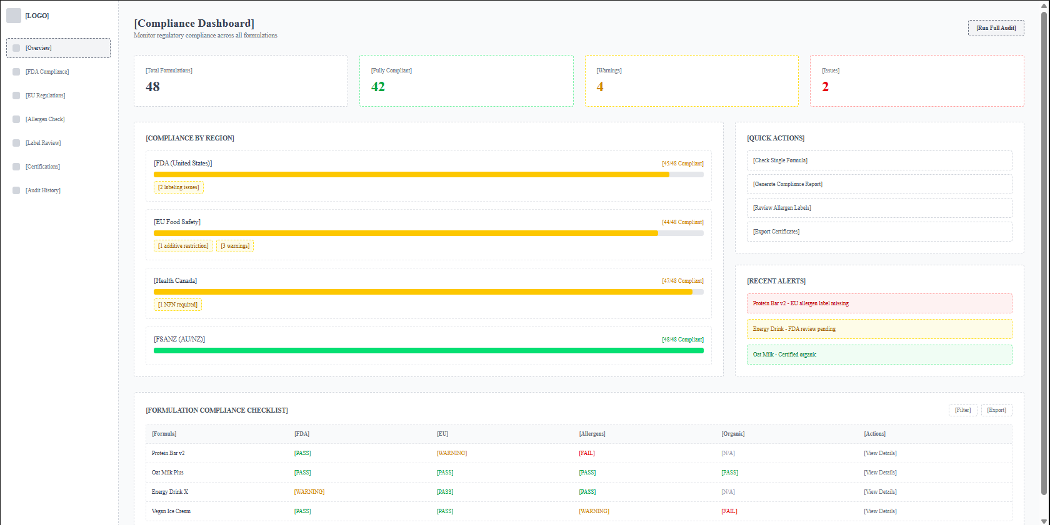

Slide 20
CONCLUSION
Slide 10: Conclusion
Key Takeaways
AI-driven food formulation platform.
Supports Expert and Guided workflows.
Simplifies ingredient selection and formulation.
Ensures regulatory compliance.
Benefits
✓ Faster Development
✓ Better Accuracy
✓ Reduced Effort

